Slide 1

E&P Weekly Update
December 7, 2015
Week 12

Slide 2
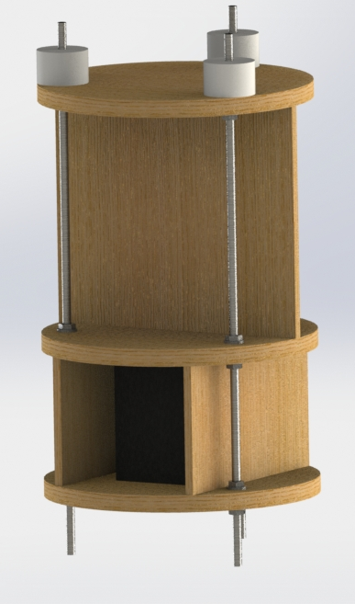
Electronics
Avionics bay v2 model completed(for now)
Talking to structures
Need to model all components
if you need any, tell me.

Slide 3
Launch Box
Tommy learned a lot about the launch box on Saturday, and we’re confident that we can get it up to par after finals
The rest of us are finalizing electronics including antenna and data collection

